Slide 1
RL PROJECT
Topic : Games using openGYM
TEAM
Sai Bhargav - Space invader’s agent and Autonomous Taxi.
Varun Reddy - Flappy bird game.

Slide 2
FLAPPY BIRD
Flappy bird is a mobile game invented in 2014.
It has since been implemented in PyGame but most interestingly it lends itself well to reinforcement learning.
The agent can only perform 2 actions ( flap or do nothing) and is only interested in 1 environmental variable( Pipes ).
Bird need to survive by going through the pipes, Bird touches the pipe then game is over.

Slide 3
Q-learning
Q-learning is a model-free reinforcement learning algorithm which is generally used to learn the best action for a agent to take given a particular state.
When the agent takes an action in a particular state it receives a reward and the goal of the agent is ti maximise its total reward such that when taking an action it must also take the potential future reward into account.

Slide 4
Deep Q-learning
Deep Q-learning which used a deep neural network to paproximate the values. This approximation of values does not hurt as long as the relative importance is preserved.
The basic working step for Deep Q-learning is that the initial state is fed into the neural network and it returns the Q-value of all possible actions as on output.
Basic concept of Deep Q-learning is instead of going with the table format, we can initialize neural network for choosing an action.

Slide 5
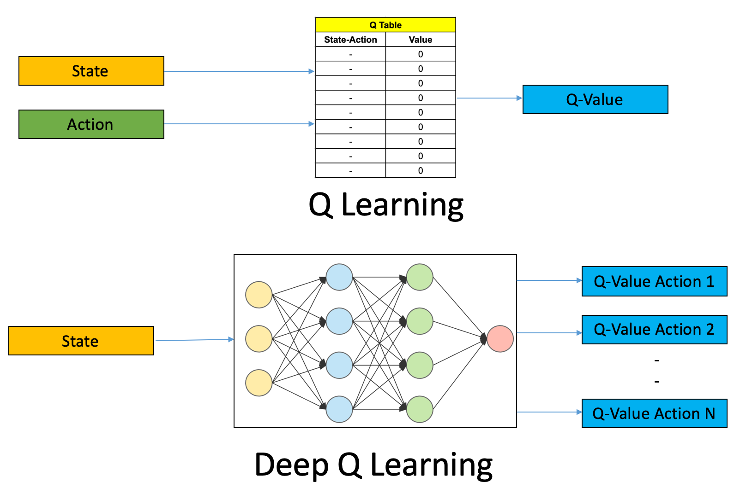
Q-learning vs Deep Q-learning

Slide 6
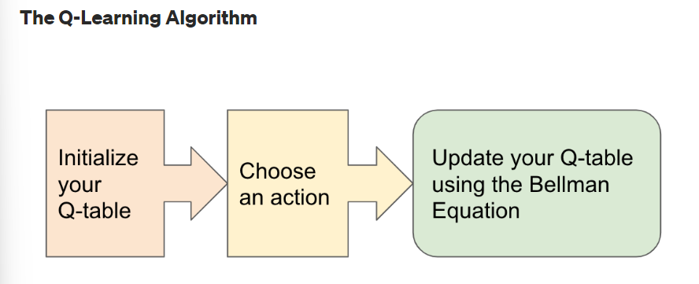
Vanilla Q-learning

Slide 7
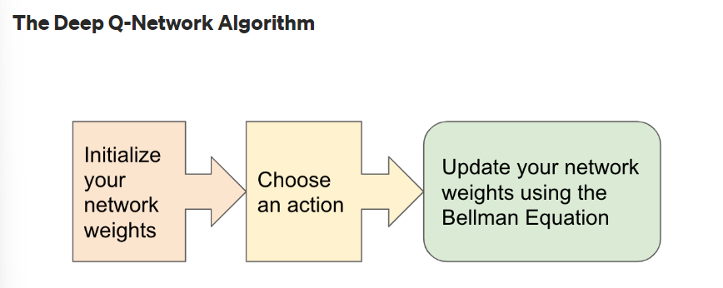
Deep Q-learning

Slide 8
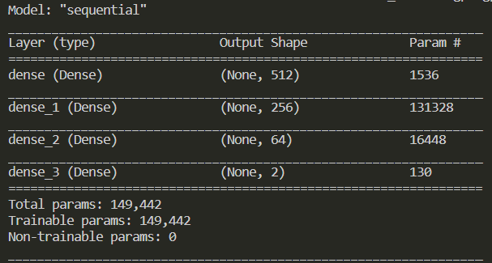
Neural Network Architecture used

Slide 9
Set Up
As we can’t run pygame in Google Colab, You need to have Anaconda installed in your PC.
Step 1: cd to required directory
Step 2: conda create –name ENVNAME python=3.6 -> For creating an Anaconda environment to run the model.
Step 3: conda activate ENVNAME
Step 4: pip install tensorflow==2.3.1 gym gym[atari] keras-rl2 -> Downloading the tensorflow, keras and gym packages.
Step 5: pip install flappy-bird-gym -> For downloading flappy bird interface from Open AI Gym.

Slide 10
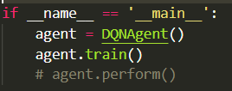
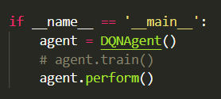
How to Run
Train model:
Uncomment train method and comment perform method in
flappyDQN.py.
Evaluate model:
Comment train method and uncomment the perform method in
flappyDQN.py.
Run the code using python flappyDQN.py

Slide 11
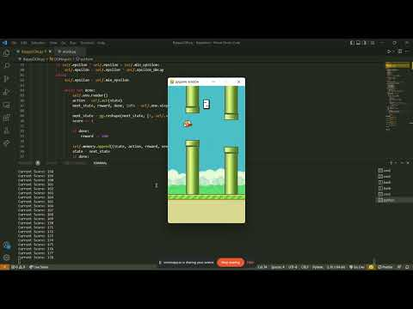
Results
Code : https://github.com/varunreddy-ch/FlappyBirdRL

Slide 12
SPACE INVADERS AGENT
In this environment, we basically have a shooting spaceship which need to maximise its score by shooting the target. It gets 3 lives in each run.
We make our model take random actions and see it performs really bad. Now we try to enforce the RL algorithms. We basically use a DQN agent which is a actor critic method.
We first build a neural network as the model needs to understand the scene. So we build a sequential model with various convolution and pooling layers.

Slide 13
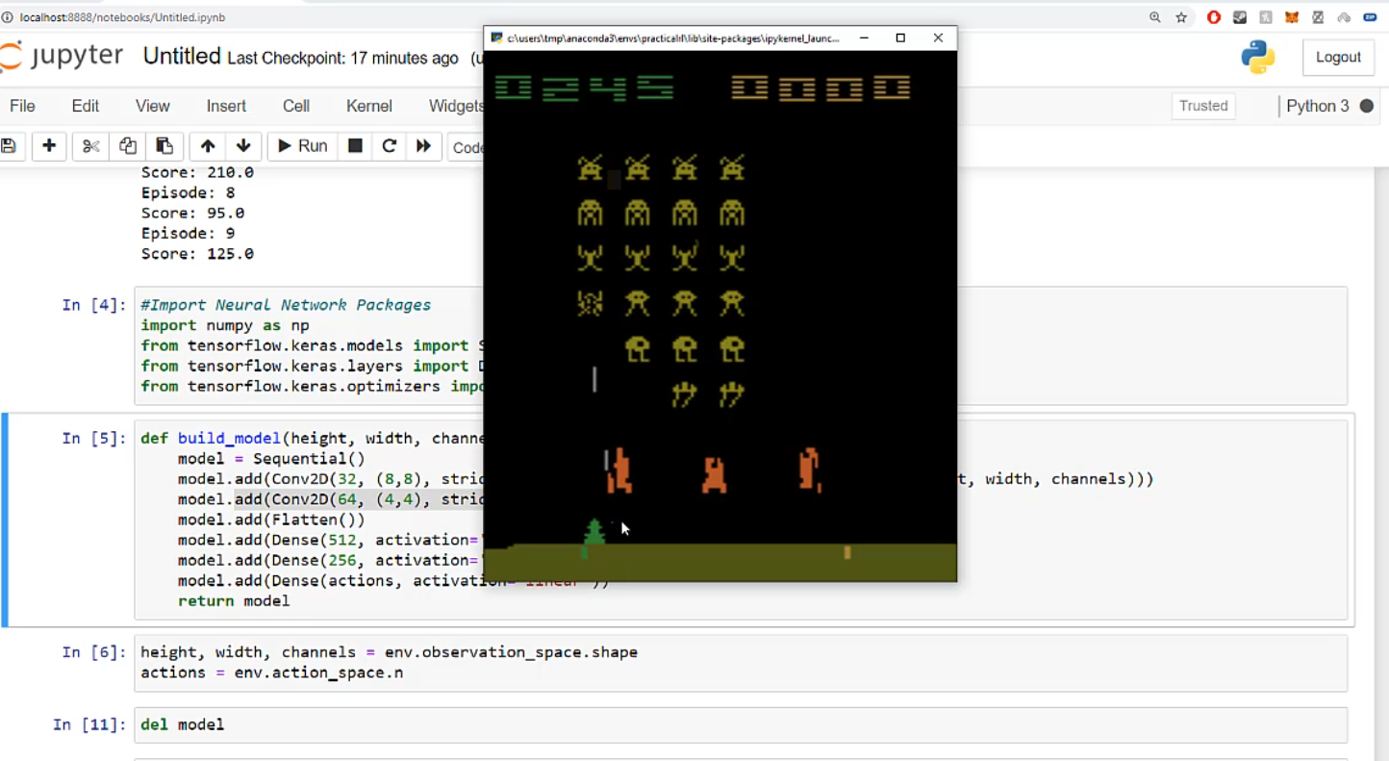
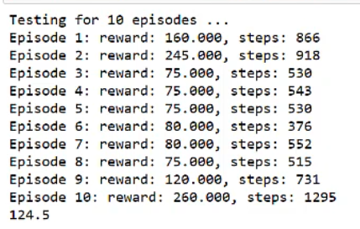
We now initiate the DQN agent and build the model. We use the Adam optimiser with a learning rate of 0.0001
We use the epsilon greedy policy with sequential memory provided by the keras reinforcement learning library.

Slide 14
TAXI TO PICK UP AND DROP
There are four different given locations and our aim is to drop a passenger from one location to another in least amount of time.
We initially take some random actions, see we get very bad reward and now start building our model.
We train our model for 10000 episodes using Q learning where we basically store the action values in a Q table.
We finally take the maximum action value as we explore and fill the Q table.

Slide 15
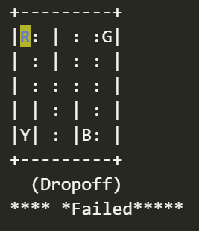

Since we just update the Q table, we don’t need any CNN model to visualise the agent. The agent performs better and better as we train it.
To run the code, install the dependencies gym gym[atari] tensorflow and required packages and simply run the code in the local system.

Slide 16
THANK YOU

